Slide 1


HEP NTUA Weekly Report 11/3/2021
George Bakas

Slide 2
Summary
ttX analysis:
Production of UL files
2016 (both pre and postVFP) is missing bTagging WP’s and scale factors
Acceptance Problem:
We tried several approaches
Discussion --> we applied geometrical matching on our jets
Removed matching from all our code
Doesn’t seem to fix the problem (Giannis)
Z’ analysis
Switch to UL files for Z’ (missing: 2016_postVFP (all widths) and 2016_preVFP, 2017, 2018 10% and 30% width files)
Email to MC generation group
Trying to switch to more sensitive variables
Chi (dijet) is not suitable for this type of analysis → Asymptotic limits
Most analyses use the mJJ variable
All distributions are for 2017
mJJ sensitivity (both stack and only with ttbar) with mJJ > 1600 GeV
Implementation of |Δy| < 1 cut
Chi distributions over different mJJ ranges (next week)

Slide 3
Sensitivity Plots

Slide 4
Sensitivity Plots (ttbar vs Z’) mJJ vs chi, mZ’ = 2TeV, w = 1%

Slide 5
Sensitivity Plots (ttbar vs Z’) mJJ vs chi, mZ’ = 2.5TeV, w = 1%

Slide 6
Sensitivity Plots (ttbar vs Z’) mJJ vs chi, mZ’ =3TeV, w = 1%

Slide 7
mJJ Stack Plots without Implementation of |Δy| < 1
M:2TeV, W=1%
M:3TeV, W=1%
M:2.5TeV, W=1%
M:4TeV, W=1%

Slide 8
mJJ Stack Plots with Implementation of |Δy| < 1
M:2TeV, W=1%
M:3TeV, W=1%
M:2.5TeV, W=1%
M:4TeV, W=1%

Slide 9
BACKUP

Slide 10
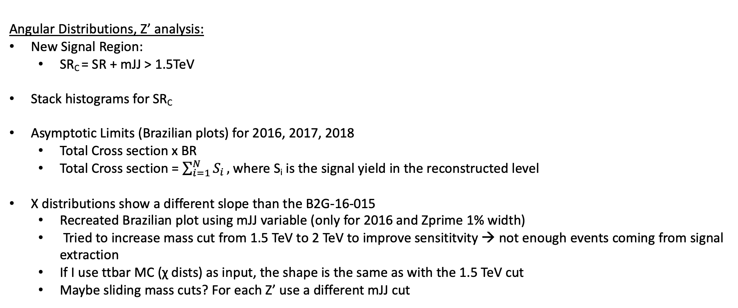
Summary
Angular Distributions, Z’ analysis:
New Signal Region:
SR_{C} = SR + mJJ > 1.5TeV
Stack histograms for SR_{C}
Asymptotic Limits (Brazilian plots) for 2016, 2017, 2018
Total Cross section x BR
Total Cross section = $\sum_{i=1}^{N}{S_{i}},$where S_{i} is the signal yield in the reconstructed level
Χ distributions show a different slope than the B2G-16-015
Recreated Brazilian plot using mJJ variable (only for 2016 and Zprime 1% width)
Tried to increase mass cut from 1.5 TeV to 2 TeV to improve sensititvity → not enough events coming from signal extraction
If I use ttbar MC (χ dists) as input, the shape is the same as with the 1.5 TeV cut
Maybe sliding mass cuts? For each Z’ use a different mJJ cut

Slide 11
Signal Selection
Control Region Selection
Variables | Selected Cut
pT (both leading jets) | > 400 GeV
Njets | > 1
N leptons | = 0
|eta| (both leading jets) | < 2.4
mJJ | > 1000 GeV
jetMassSoftDrop (only for fit) | (50,300) GeV
Top Tagger | > 0.2, 0, 0.1
B tagging (2 btagged jets) | > Medium WP
Signal Trigger
Variables | Selected Cut
pT (both leading jets) | > 400 GeV
Njets | > 1
N leptons | = 0
|eta| (both leading jets) | < 2.4
mJJ | > 1000 GeV
jetMassSoftDrop (only for fit) | (50,300) GeV
Top Tagger | > 0.2, 0, 0.1
B tagging (0 btagged jets) | < Medium WP
Control Trigger

Slide 12
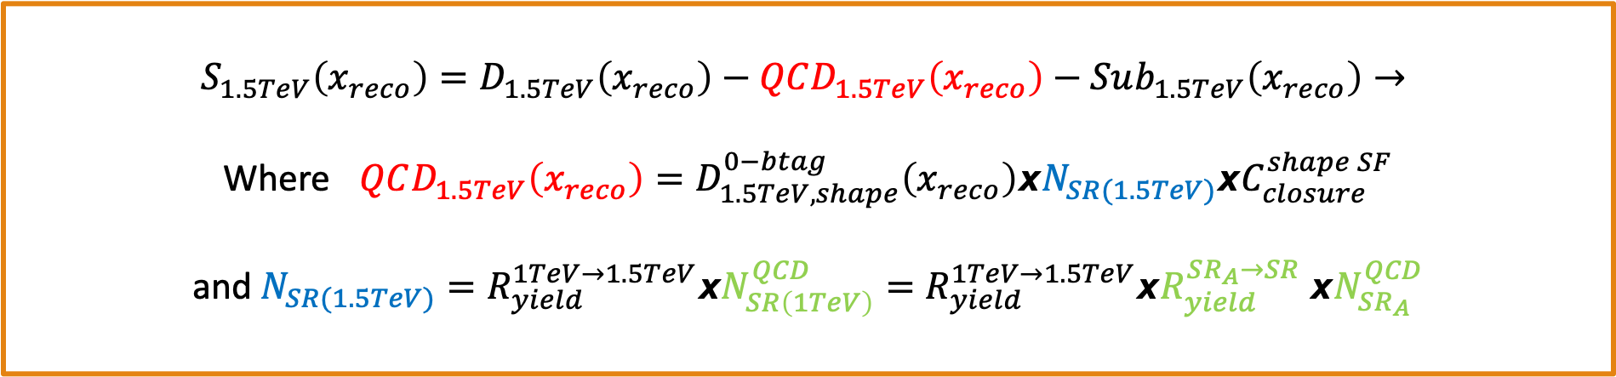
Signal Extraction
$$S_{1.5TeV}\left(x_{reco}\right)=D_{1.5TeV}\left(x_{reco}\right)−QCD_{1.5TeV}\left(x_{reco}\right)−Sub_{1.5TeV}\left(x_{reco}\right)→$$
Where $QCD_{1.5TeV}\left(x_{reco}\right)=D_{1.5TeV, shape}^{0−btag}\left(x_{reco}\right)xN_{SR(1.5TeV)}{xC}_{closure}^{shape SF}$
and $N_{SR(1.5TeV)}=R_{yield}^{1TeV→1.5TeV}xN_{SR\left(1TeV\right)}^{QCD}=R_{yield}^{1TeV→1.5TeV}xR_{yield}^{SR_{A}→SR} {xN}_{SR_{A}}^{QCD}$
The variable of interest here: x_{reco} → χ
1.5 TeV refers to the mJJ cut
We deploy a fit in the Signal Region (2btag) to extract the $N_{QCD}^{fit}$ in SRA (mJJ > 1TeV)
$$D{\left(m^{t}\right)}^{(i)}=N_{tt}^{(i)}T^{(i)}\left(m^{t},k_{MassScale}, k_{MassResolution}\right)+N_{bkg}^{(i)}B\left(m^{t} \right)\left(1+k_{1}x\right)+N_{sub}^{(i)}O^{(i)}\left(m^{t}\right)$$

Slide 13
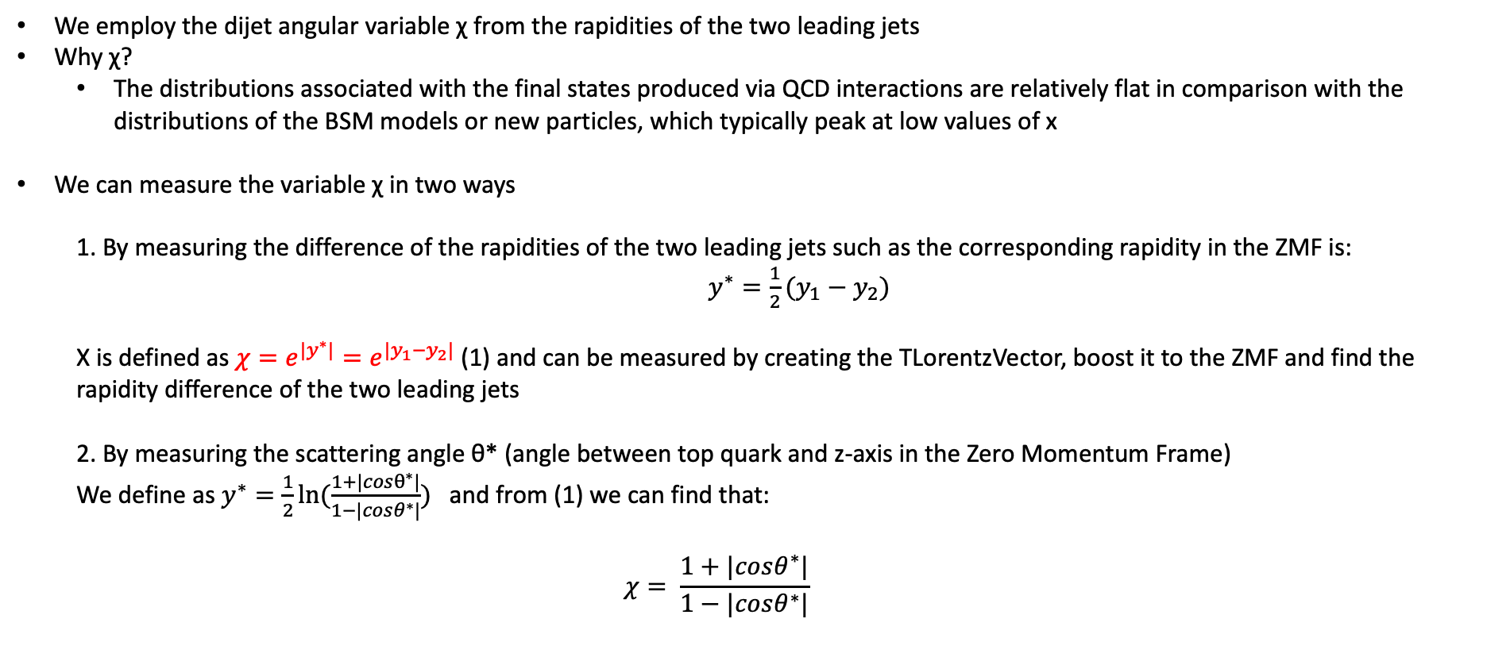
Top Angular Distributions
We employ the dijet angular variable χ from the rapidities of the two leading jets
Why χ?
The distributions associated with the final states produced via QCD interactions are relatively flat in comparison with the distributions of the BSM models or new particles, which typically peak at low values of x
We can measure the variable χ in two ways
1. By measuring the difference of the rapidities of the two leading jets such as the corresponding rapidity in the ZMF is: $y^{∗}=\frac{1}{2}(y_{1}−y_{2})$
Χ is defined as $χ=e^{{|y}^{∗}|}=e^{|y_{1}−y_{2}|}$ (1) and can be measured by creating the TLorentzVector, boost it to the ZMF and find the rapidity difference of the two leading jets
2. By measuring the scattering angle θ* (angle between top quark and z-axis in the Zero Momentum Frame)
We define as $y^{∗}=\frac{1}{2}ln⁡(\frac{1+|cosθ^{∗}|}{1−|cosθ^{∗}|})$ and from (1) we can find that:
$$χ= \frac{1+|cosθ^{∗}|}{1−|cosθ^{∗}|}$$

